Slide 1

theflavory.me: customizing recipes through ingredient recommendations
Brandon Kelly

Slide 2
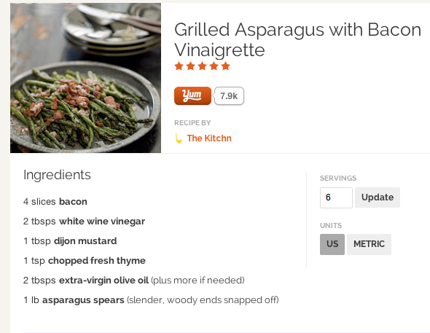

Problem: Customizing recipes
Looks good. But I’d like to make this a little more interesting, what can I add?
Numerous recipe recommendation
services, but nothing at the ingredient
level.

Slide 3
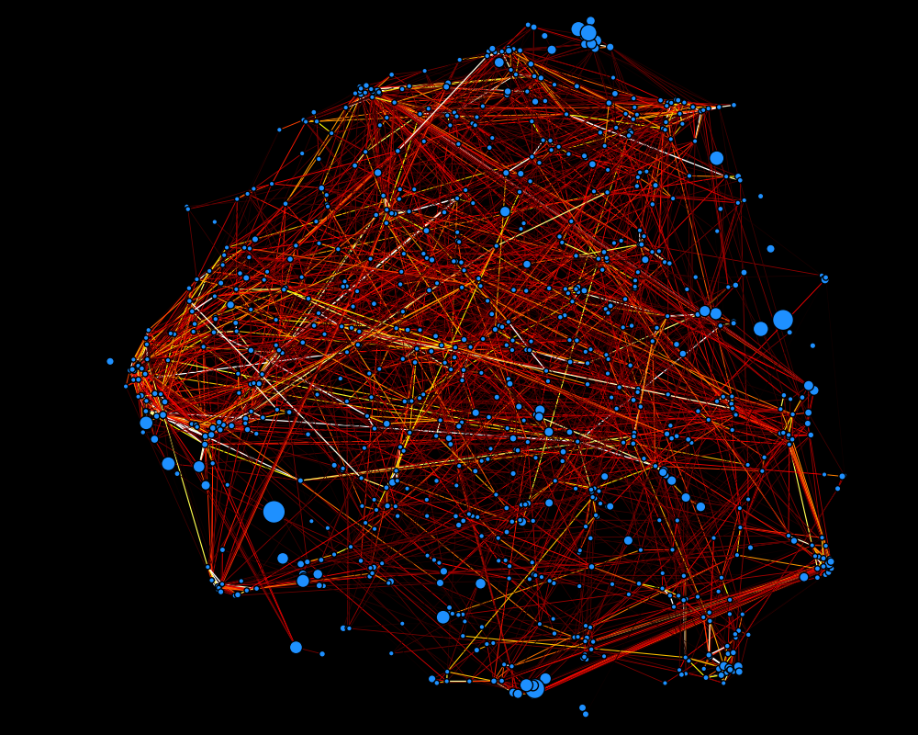
Can we recommend ingredients in a data-driven way?
Trained using ~ 110,000 recipes and
816 unique ingredients within at
least 50 recipes (yummly.com API)
Edges: Pointwise
Mutual Information

Slide 4
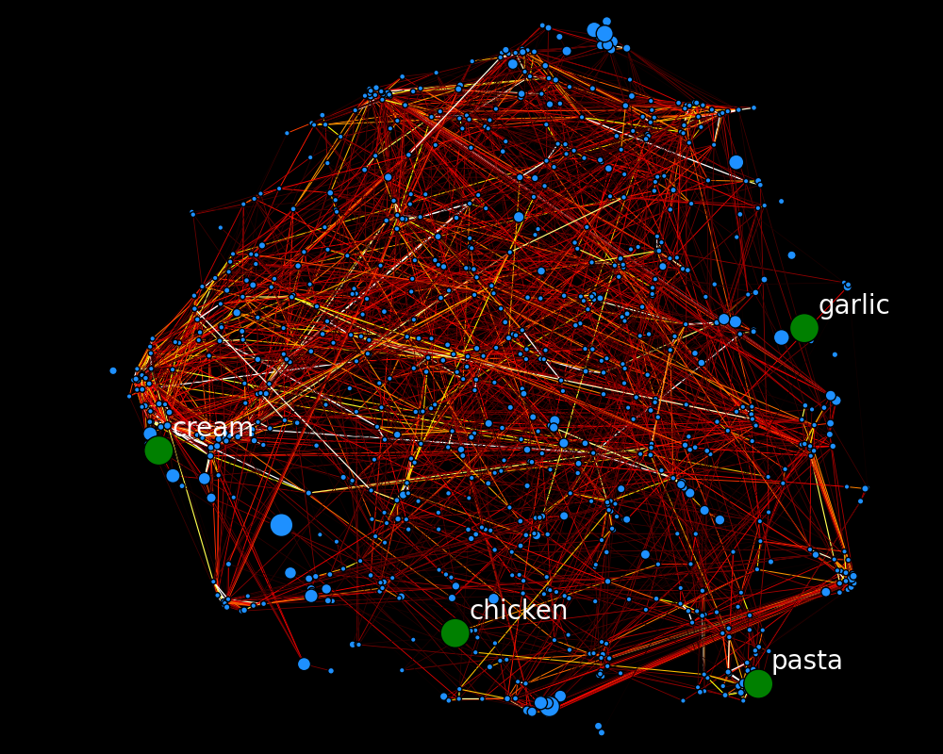
Can we recommend ingredients in a data-driven way?
Trained using ~ 110,000 recipes and
816 unique ingredients within at
least 50 recipes (yummly.com API)
Edges: Pointwise
Mutual Information

Slide 5
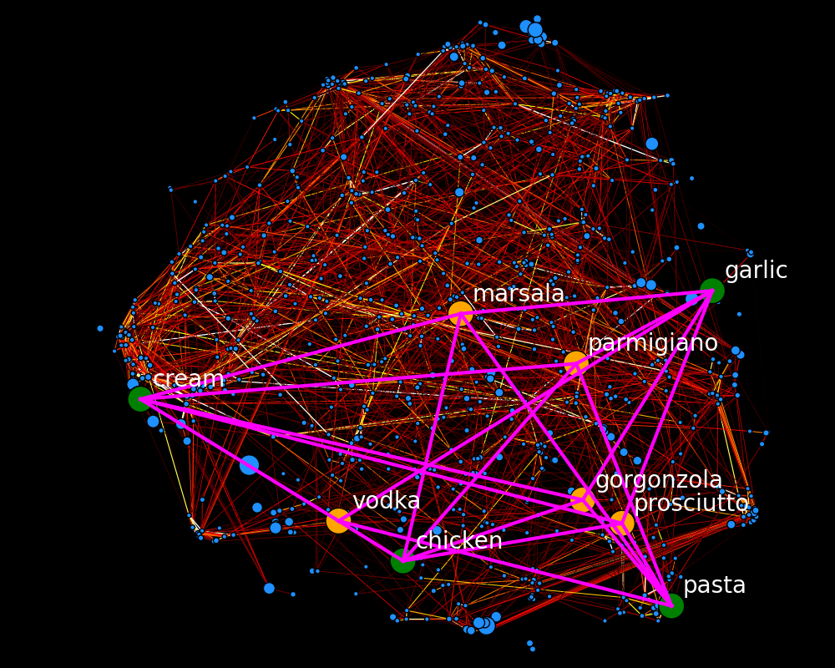
Can we recommend ingredients in a data-driven way?
Trained using ~ 110,000 recipes and
816 unique ingredients within at
least 50 recipes (yummly.com API)
Edges: Pointwise
Mutual Information

Slide 6




Brandon Kelly

Slide 7
Analysis: Recommending similar ingredients
Learn a graph using the pointwise mutual information to define similarity:
Shrink the estimated PMI toward independence (PMI = 0) for stability:
Choose the shrinkage parameter M through 8-fold cross-validation

Slide 8
Validation
Split the recipes into training (75%) and test (25%) set
Learn the graph using the training set
Randomly remove 1 ingredient from each recipe in the test set
Left-out ingredient was in the top 10 recommended ingredients 25% of the time
Randomly recommended ingredient contained the left out ingredient only 2% of the time.

